Slide 1
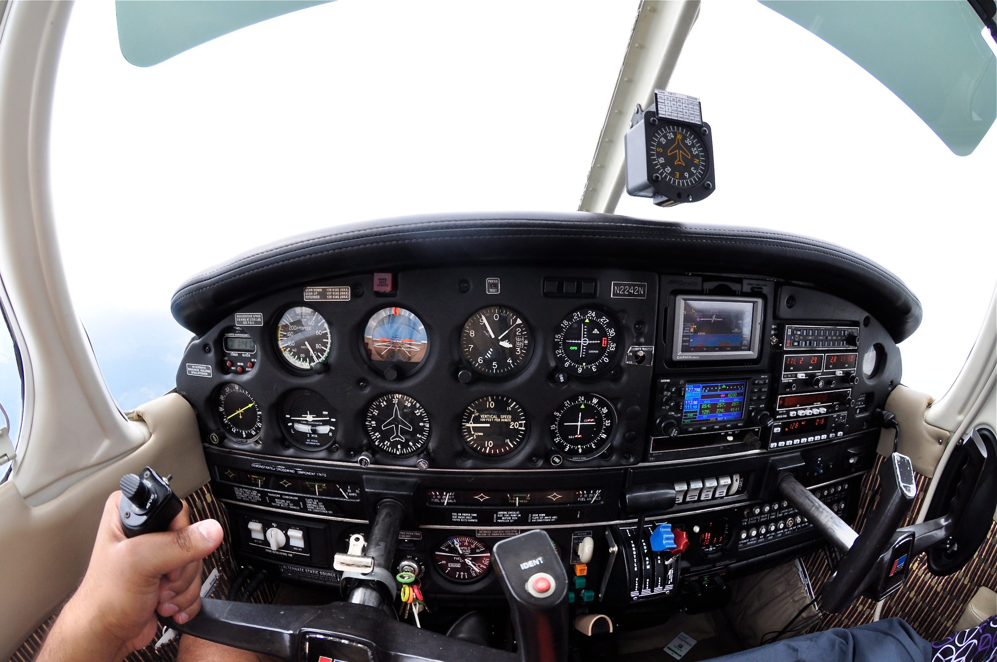
St Louis Flying Club

Slide 2
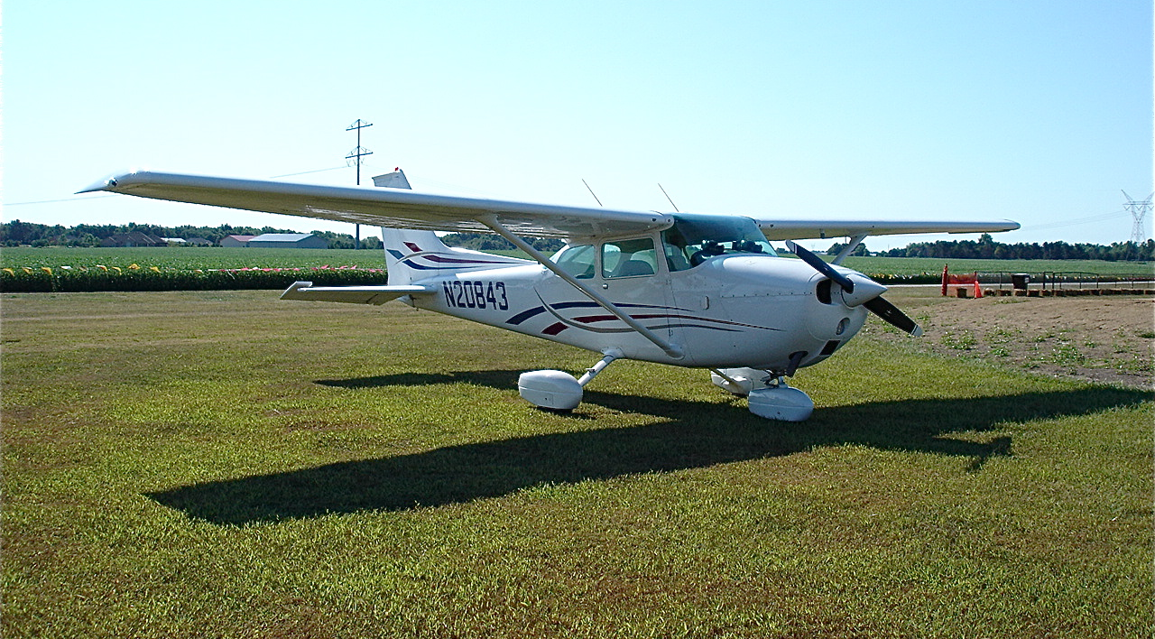
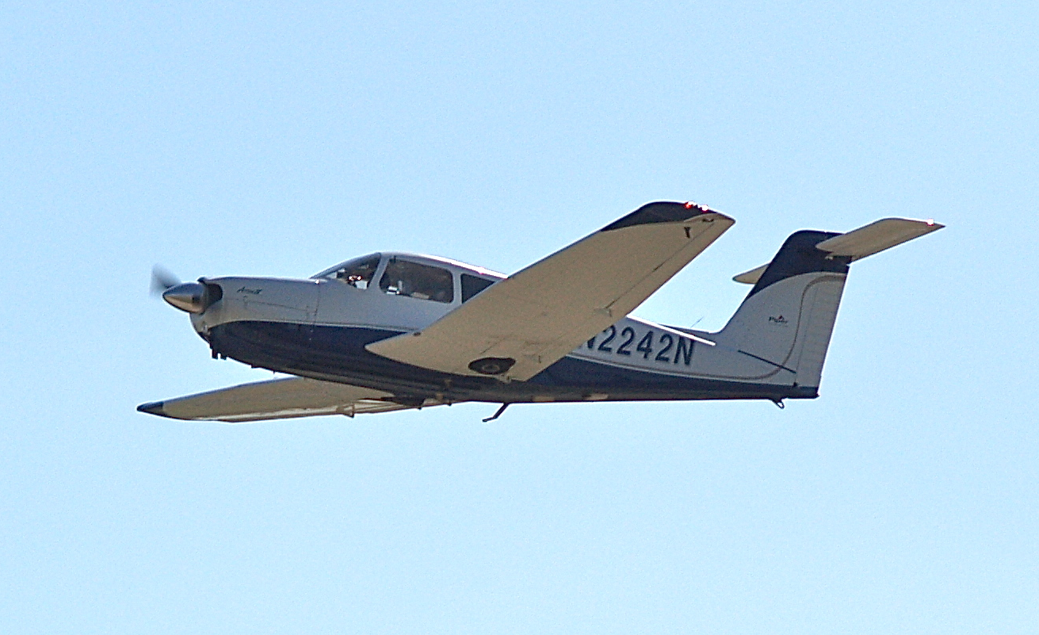
Actions From May Meeting
Aircraft cleaning supplies have been placed in both hangars (Phil and Charley).
Reminder - limited memberships to be converted to full memberships or sold before January 2013.
Modifications to insurance policy to cover Air Associates instructors (Chris)
Responsibility matrix assembled (Charley/Todd)
Social events – fly-in destinations page added to web.

Slide 3
Responsibility Matrix

Slide 4
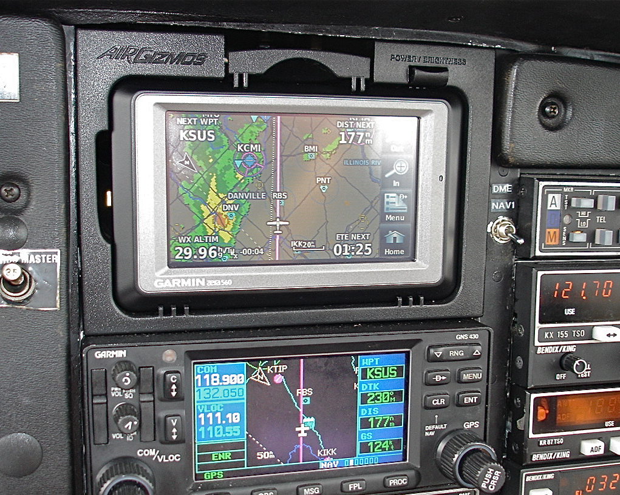
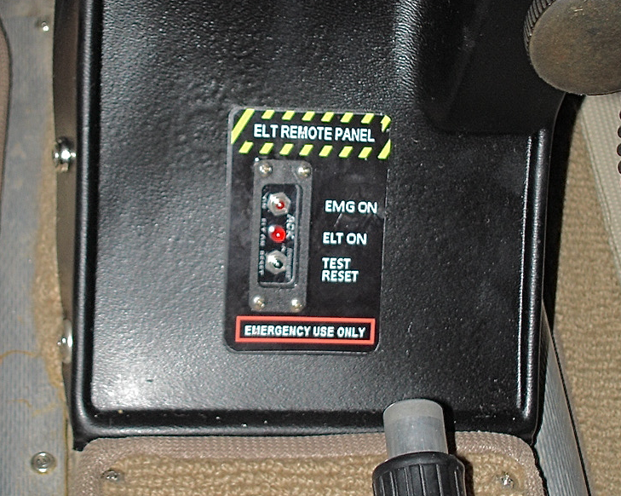
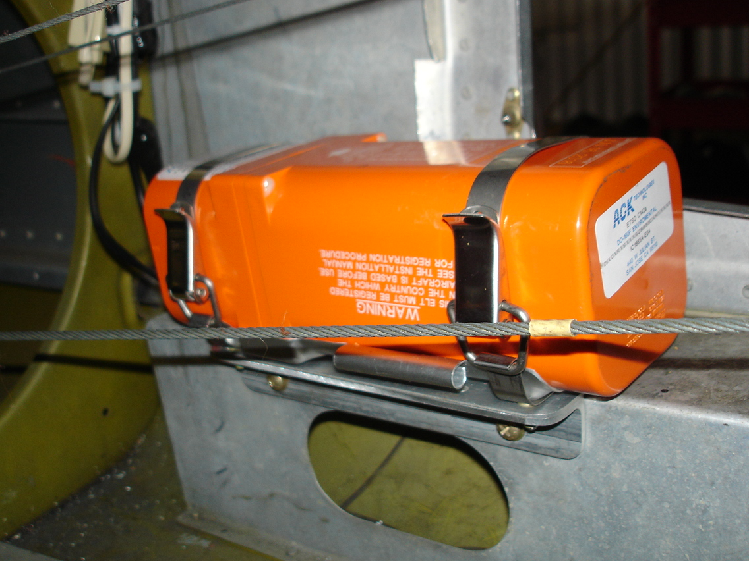
Aircraft Upgrade/Mod Status
☑ Garmin Aera 560 installed in Arrow.
406 Mhz ELT installed
  Optional GPS Input to be connected in next few weeks
Remove King GPS – Sold for $1,025 on Ebay
☐ Zaon traffic monitor – postponed – Antenna issues
☐ Remove DME – postponed

Slide 5
Club Reincorporation Proposal
Reincorporation Plan:
Form new 501c(7) not for profit corporation entitled “St Louis Flying Club, Inc”
Avoid need to transfer club assets to the new corporation by using the name on aircraft registrations.
Dissolve the current benevolent corporation. Requires filing paper work with circuit court.
Modify club by-laws to improve liability protection.
Begin filing annual report and income tax return.
Delay formation of new corporation until early 2012 to avoid need for 2011 tax return.
Proposal:
Pre approve expense line for up to $2500 for reincorporation of the club. (estimate is ~ $1500).
Funds will be used to
  Hire corporate attorney, Tom Mug (Gallop Law Firm), to provide consultation and assist with circuit court filings.
  Prepare articles of incorporation and new by-laws
  Transfer club assets and member share certificates
  File with State of MO to dissolve existing benevolent corporation
Final Articles of Incorporation and By-laws will be brought before the members for approval.

Slide 6

New Business
Standardization of operating procedures
  Aircraft refueling
  Addition of oil
  Aircraft cancelation
  …
XM radio subscription purchased for Arrow (Shiv)
Change approach to setting club meeting dates
  Select next meeting date now and let people plan around it.
  Future meeting locations (restaurant?)

Slide 7
New Upgrade Proposals
New 406 Mhz ELT for N20843 - $600
  121.5 MHz ELT
    12 NM Radius, 452 Sq Mi
    Average 6 Hour Notification
  406 MHz ELT
    2 NM Radius, 12.5 Sq Mi
    Average 1 Hour Notification
  406 ELT with GPS
    0.05 NM Radius, 0.008 Sq Mi
    Average 5 minute Notification
121.5: 12 NM
406: 2 NM
406 w/GPS: 0.05 NM
$600 from Aircraft Spruce

Slide 8
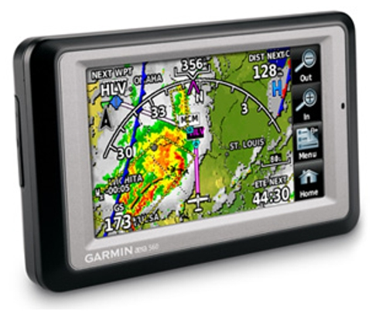
Garmin Aera for Cessna

Slide 9
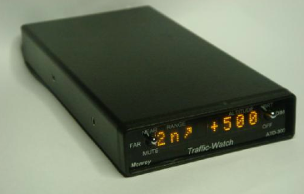
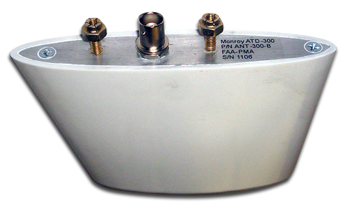
Traffic Warning
Directional Antenna
Upgrade our exiting Cessna unit and new antenna for
$765.00
New unit and antenna for Arrow is $990
ARINC interface to GNS-430W is $395 (shows up to 5 aircraft)

Slide 10
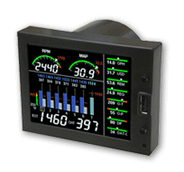
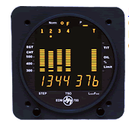
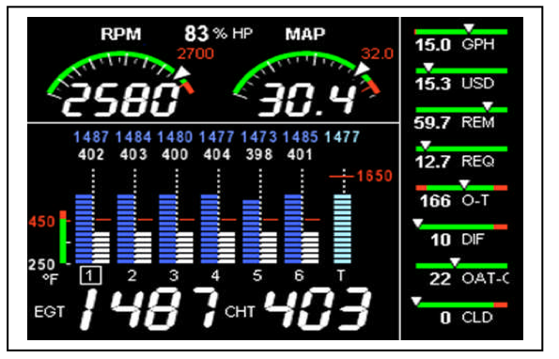
Engine Monitor Upgrade
EDM has upgrade option for EDM-700 Engine monitor with $200 rebate good through Dec 2011.
Exchange existing EDM-700 for EDM-730 for $865.00 (normally $1065)
To get % HP, need following inputs
  MP = $230
  OAT = $155
  RPM = $355 (Have on Cessna)

Slide 11

Club Officer Elections
2011 Officers – Thank You
  President: Todd Michal
  Vice President: Chris Tebbe
  Secretary: Mike Warakomski
  Treasurer: Mike McBride
  Maintenance: John Heilmann
2012 Officer Elections
  President:
  Vice President:
  Secretary:
  Treasurer:
  Maintenance:
Shiv Photo: Flying into the sunset at 10,000 ft

